Slide 1
Distributed Network Programming

Slide 2
Outline
TCP, UDP, IP Address and Ports
Socket Programming using TCP and UDP
Working with URLs and URL Connection Class
Email Handling using Java Mail API
Architecture of RMI
Creating and Executing RMI Applications
Architecture of CORBA
RMI vs CORBA
IDL and Simple CORBA Program

Slide 3
Networking Basics
Networking is the practice of connecting multiple devices together to facilitate data communication and resource sharing.
In the context of Java programming, networking involves using Java's networking libraries to develop applications that can communicate over networks.
IP addresses: Every device connected to a network is assigned an IP (Internet Protocol) address, which uniquely identifies it on the network. IP addresses can be either IPv4 or IPv6.

Slide 4
Networking Basics (contd...)
Protocols: Protocols define the rules and standards for communication between devices. Two commonly used protocols in networking are TCP (Transmission Control Protocol) and UDP (User Datagram Protocol).
TCP (Transmission Control Protocol): TCP is a reliable, connection-oriented protocol that guarantees the delivery of data in the order it was sent. It provides error checking and flow control mechanisms.
UDP (User Datagram Protocol): UDP is a lightweight, connectionless protocol that does not guarantee reliable data delivery or ordering. It is often used for real-time applications where speed is prioritized over reliability.

Slide 5
Networking Basics (contd...)
Ports: Ports are used to differentiate between different network services or applications running on a device. A port is a numeric identifier that specifies a particular service or application.
Network Layers: Networks are organized into layers, each responsible for specific functions. The OSI (Open Systems Interconnection) model and the TCP/IP (Transmission Control Protocol/Internet Protocol) model are commonly used to describe network layers.

Slide 6
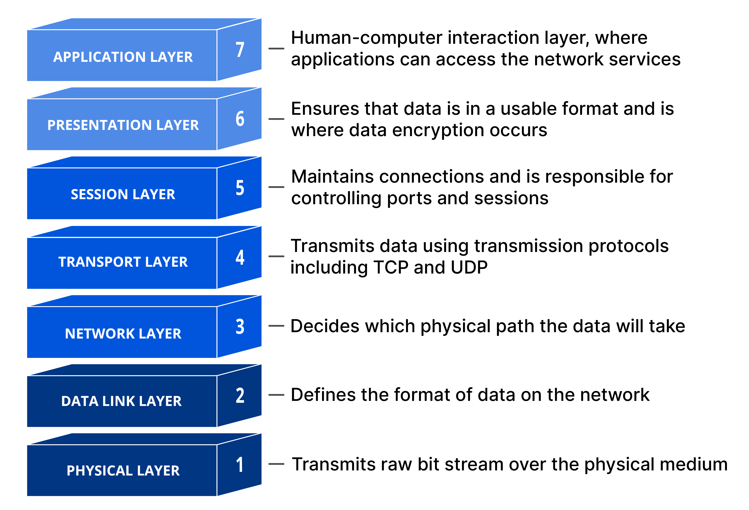
OSI Model

Slide 7
TCP (Transmission Control Protocol)
TCP is a connection-oriented transport layer protocol that provides reliable, ordered, and error-checked delivery of data between devices on a network
Characteristics
Connection-oriented: TCP establishes a connection before data transfer, ensuring a reliable and ordered exchange.
Reliability: Guarantees data delivery in the order it was sent without loss.
Error Checking: Detects and retransmits lost or corrupted data to ensure integrity.
eg: File transfer, web browsing

Slide 8
UDP (User Datagram Protocol)
UDP is a connectionless transport layer protocol that offers a lightweight mechanism for data transfer without the overhead of a connection.
Characteristics
Connectionless: Does not establish a connection before sending data, making it faster but less reliable.
Unreliable: Does not guarantee delivery, ordering, or error checking.
Low Overhead: Suitable for real-time applications with low latency requirements
eg: Video streaming, online gaming

Slide 9
Introduction to Socket
Socket programming is a fundamental concept in network programming that allows communication between two endpoints (typically a client and a server) over a network.
In Java, the Socket class is used to establish a network connection between a client and a server.
The client-side socket is responsible for initiating the connection, while the server-side socket listens for incoming client connections.
Socket communication typically involves two types: TCP (Transmission Control Protocol) and UDP (User Datagram Protocol).

Slide 10
Socket Programming (contd...)
Socket programming supports various communication protocols, such as TCP (Transmission Control Protocol) and UDP (User Datagram Protocol), depending on the requirements of the application.
TCP sockets provide reliable, ordered, and error-checked communication, making them suitable for applications that require guaranteed data delivery.
UDP sockets provide a connectionless and unreliable communication mechanism, which is useful for real-time applications or situations where speed is prioritized over reliability.
Socket programming allows developers to build network applications such as chat systems, file transfer protocols, remote control applications, and more.

Slide 11
Socket Programming (contd...)
Socket programming allows for bidirectional communication between the client and the server. Clients can send requests to the server, and the server can respond with the requested data or perform actions based on the client's request.
The client-side socket initiates the connection by specifying the server's IP address and port number to establish a communication channel.
The server-side socket listens on a specific port for incoming client connections. Once a client connects, the server accepts the connection and can communicate with the client.

Slide 12
Understanding Port
In the context of networking, a port is a communication endpoint used by applications to establish connections and exchange data over a network.
Ports are identified by numbers, known as port numbers, which range from 0 to 65535.
Port numbers up to 1023 are well-known ports and are reserved for specific services and protocols. For example, port 80 is commonly used for HTTP (Hypertext Transfer Protocol), and port 443 is used for secure HTTPS (HTTP over SSL).

Slide 13
Understanding Port (contd...)
Port numbers from 1024 to 49151 are registered ports, which can be assigned by software applications and organizations for specific purposes.
Port numbers from 49152 to 65535 are dynamic or private ports, which can be used by applications for temporary or private purposes.
When a client wants to establish a connection to a server, it needs to specify the server's IP address and the port number to which it wants to connect.

Slide 14
Understanding Port (contd...)
The server listens on a specific port for incoming connections. Once a connection request arrives on that port, the server accepts the connection and establishes communication with the client.
Each network protocol, such as TCP or UDP, has its own set of port numbers. For example, TCP and UDP both use port numbers to identify specific processes or services running on a device.

Slide 15
Understanding Port (contd...)
Port numbers provide a way for multiple applications or services to coexist on the same device without conflicts. Each application can use a unique port number for its communication needs.
In Java, the ServerSocket class is used to bind a server-side socket to a specific port, allowing the server to listen for incoming connections on that port.

Slide 16
Networking Classes in Java
Java provides a set of built-in classes and interfaces in the java.net package to facilitate network programming.
These classes and interfaces include Socket, ServerSocket, URL, URLConnection, InetAddress, and more.
The Socket class represents a client-side endpoint for communication with a server. It allows establishing a TCP connection to a remote server and provides input and output streams for sending and receiving data.
The ServerSocket class represents a server-side endpoint that listens for incoming client connections. It can accept client connections and create separate Socket objects to communicate with each client.

Slide 17
Creating Own Server and Client in Java
In Java, you can create your own server and client applications using the ServerSocket and Socket classes.
The server application typically listens on a specific port using a ServerSocket object. It accepts incoming client connections using the accept() method of the ServerSocket class.
Once a client connection is accepted, a new Socket object is created on the server side to communicate with the client.

Slide 18
Creating Own Server and Client in Java (contd...)
The client application creates a Socket object and specifies the server's IP address and port number to establish a connection.
Both the server and client applications can use input and output streams associated with the Socket object to send and receive data.
Communication between the server and client can be done using various protocols, such as TCP or UDP.

Slide 19
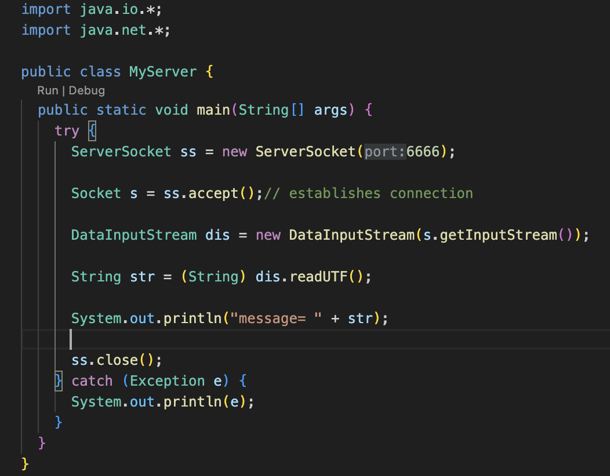
Server Side
Creation of Socket in server
Accepting any connection from client side
Creation of Input Stream to receive data

Slide 20
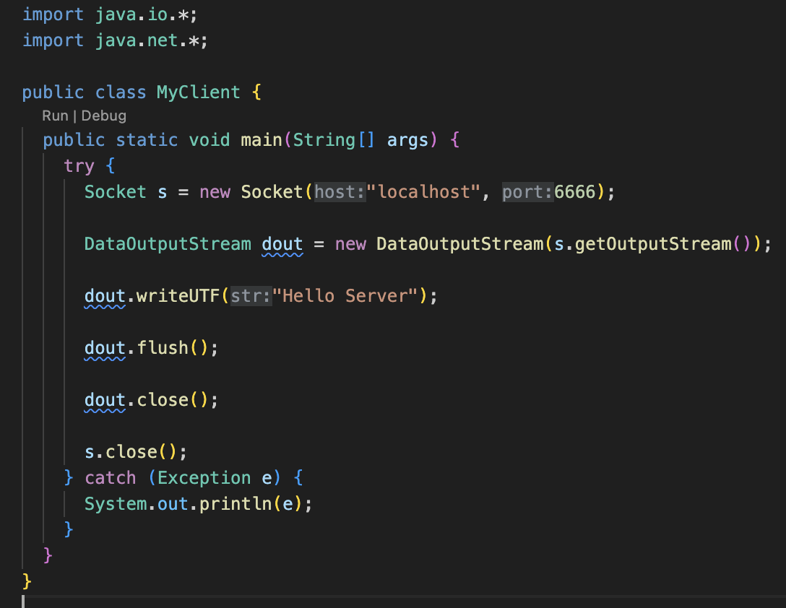
Client Side
Creating socket object to connect with the server in localhost:6666
Creating data output stream to be able to send dat
Flushing all the data to the socket

Slide 21
URL and URL connection Class
The URL class represents a Uniform Resource Locator, which is used to identify resources on the internet. It provides methods to retrieve information about the resource, such as the protocol, host, port, and file path.
The URLConnection class is an abstract class that represents a connection to a URL resource. It provides methods to read data from and write data to the resource.
The InetAddress class represents an IP address. It provides methods to retrieve the host name and IP address associated with a given host.
The openConnection() method of the URL class returns a URLConnection object that can be used to establish a connection to the resource and perform operations such as reading from or writing to it.

Slide 22
URL and URL connection Class (contd...)
The URLConnection class is an abstract class that represents a connection to a URL resource. It provides methods to read data from and write data to the resource.
Depending on the protocol specified in the URL, different subclasses of URLConnection are used, such as HttpURLConnection for HTTP connections.
The URLConnection class provides methods to set request properties, handle input and output streams, and manage connection timeouts.

Slide 23
Email Handling

Slide 24
Email Handling using Java Mail API
To send email we will have to follow SMTP (Simple Mail Transfer Protocol)
This protocol is readily available in javax.mail.* package
The Java Mail API provides a set of classes to compose, send, and receive emails in Java applications
Use cases:
Sending emails programmatically from Java applications.
Automating email-related tasks

Slide 25
Steps of using Java Mail API
Configure the mail server properties such as the host and port.
Establish a mail session with the configured properties
Pass authentication details if required.
Construct an email message using the MimeMessage class.
Set the sender, recipients, subject, and body of the email
Use the Transport class to send the message

Slide 26
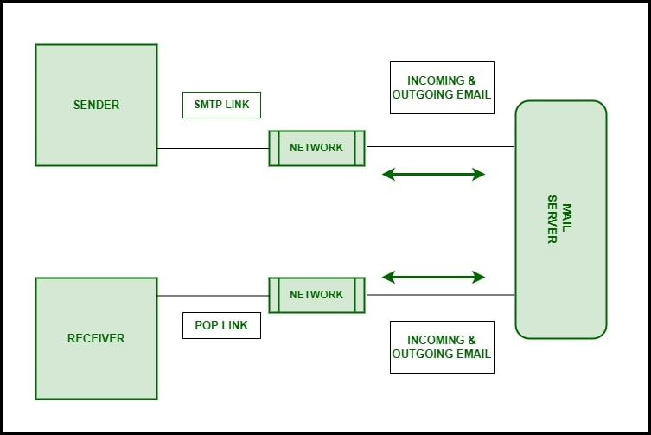
Sending & Receiving Email

Slide 27
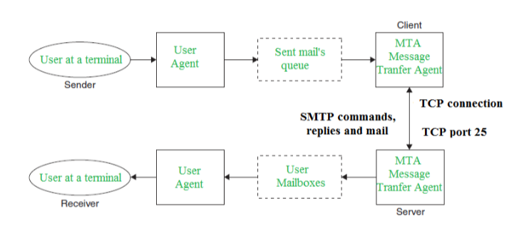
SMTP Model
Mail User Agent (MUA)
Mail Submission Agent (MSA)
Mail Transfer Agent (MTA)
Mail Delivery Agent (MDA)

Slide 28
Working of SMTP
Communication between the sender and the receiver :
The sender’s user agent prepares the message and sends it to the MTA. The MTA’s responsibility is to transfer the mail across the network to the receiver’s MTA.
To send mail, a system must have a client MTA, and to receive mail, a system must have a server MTA.
Sending Emails:
Mail is sent by a series of request and response messages between the client and the server. The message which is sent across consists of a header and a body. A null line is used to terminate the mail header and everything after the null line is considered the body of the message, which is a sequence of ASCII characters.
The message body contains the actual information read by the receipt.
Receiving Emails:
The user agent on the server-side checks the mailboxes at a particular time of intervals. If any information is received, it informs the user about the mail.
When the user tries to read the mail it displays a list of emails with a short description of each mail in the mailbox. By selecting any of the mail users can view its contents on the terminal.

Slide 29
RMI (Remote Method Invocation)

Slide 30
Architecture of RMI (Remote Method Invocation)
In an RMI application, we write two programs, a server program (resides on the server) and a client program (resides on the client).
Inside the server program, a remote object is created and reference of that object is made available for the client (using the registry).
The client program requests the remote objects on the server and tries to invoke its methods.

Slide 31
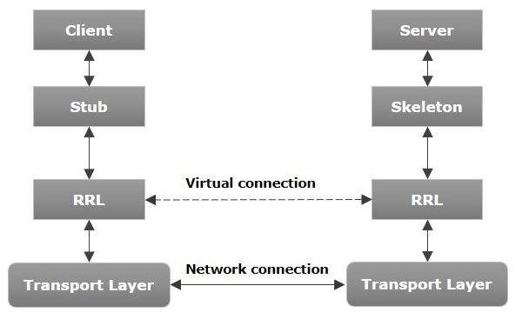

Slide 32
Architecture of RMI (contd...)
Transport Layer − This layer connects the client and the server. It manages the existing connection and also sets up new connections.
Stub − A stub is a representation (proxy) of the remote object at client. It resides in the client system; it acts as a gateway for the client program
Skeleton − This is the object which resides on the server side. stub communicates with this skeleton to pass request to the remote object
RRL(Remote Reference Layer) − It is the layer which manages the references made by the client to the remote object

Slide 33
Working of an RMI Application
When the client makes a call to the remote object, it is received by the stub which eventually passes this request to the RRL.
When the client-side RRL receives the request, it invokes a method called invoke() of the object remoteRef. It passes the request to the RRL on the server side.
The RRL on the server side passes the request to the Skeleton (proxy on the server) which finally invokes the required object on the server.
The result is passed all the way back to the client

Slide 34
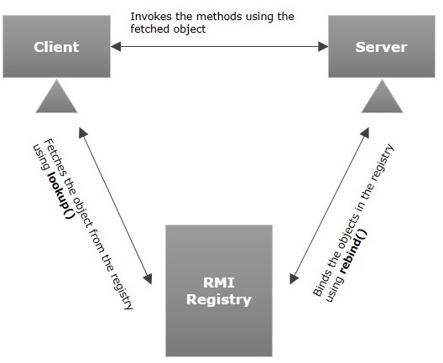
RMI Registry
RMI registry is a namespace on which all server objects are placed
Each time the server creates an object, it registers this object with the RMIregistry (using bind() or reBind() methods).
These are registered using a unique name known as bind name.
The client fetches the object from the registry using its bind name (using lookup() method).

Slide 35
Goals of RMI
To minimize the complexity of the application.
To preserve type safety.
Distributed garbage collection.
Minimize the difference between working with local and remote objects.

Slide 36
Creating and Executing RMI Applications
The RMI (Remote Method Invocation) is an API that provides a mechanism to create distributed application in java.
The RMI allows an object to invoke methods on an object running in another JVM.
The RMI provides remote communication between the applications using two objects stub and skeleton.

Slide 37
Stub
The stub is an object, acts as a gateway for the client side. All the outgoing requests are routed through it. It resides at the client side and represents the remote object. When the caller invokes method on the stub object, it does the following tasks:
It initiates a connection with remote Virtual Machine (JVM)
It writes and transmits (marshals) the parameters to the remote Virtual Machine (JVM),
It waits for the result
It reads (unmarshals) the return value or exception, and
It finally, returns the value to the caller.

Slide 38
Skeleton
The skeleton is an object, acts as a gateway for the server side object. All the incoming requests are routed through it. When the skeleton receives the incoming request, it does the following tasks:
It reads the parameter for the remote method
It invokes the method on the actual remote object, and
It writes and transmits (marshals) the result to the caller.

Slide 39
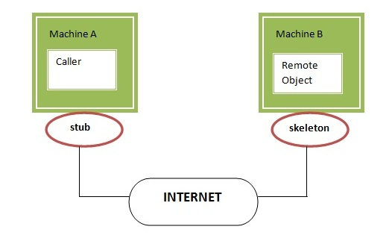

Slide 40
CORBA
The Common Object Request Broker Architecture (CORBA) is a standard defined by the Object Management Group (OMG) designed to facilitate the communication of systems that are deployed on diverse platforms
CORBA enables collaboration between systems on different operating systems, programming languages, and computing hardware
It uses an object-oriented model although the systems that use the CORBA do not have to be object-oriented
CORBA is an example of the distributed object paradigm.

Slide 41
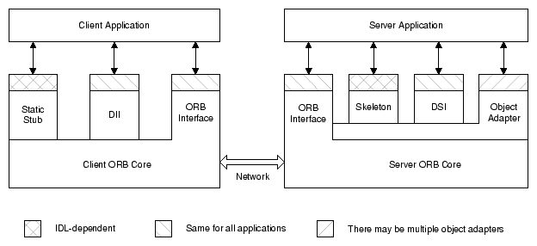
Common Object Request Broker Architecture (CORBA)

Slide 42
Architecture of CORBA (contd...)
The client can choose to make requests either using static stubs (generated from the IDL definition, see below) or using the Dynamic Invocation Interface (DII). Either way, the client directs the request into the ORB core linked into its process.
The client ORB core transmits the request to the ORB core linked with the server application.
The server ORB core dispatches the request to the object adapter that created the target object.
The object adapter further dispatches the request to the servant that is implementing the target object.
Like the client, the server can choose between static and dynamic dispatching mechanisms for its servants. It can rely on static skeletons generated from the object's IDL definition, or its servants can use the Dynamic Skeleton Interface (DSI).
After the servant carries out the request, it returns its response to the client application.

Slide 43
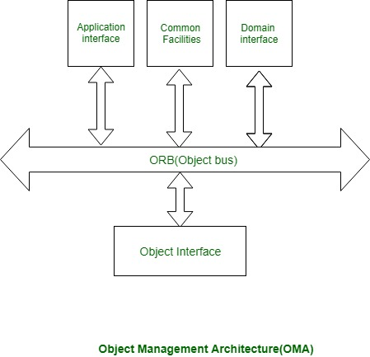
Object Management Architecture

Slide 44
Working with CORBA
Using a CORBA implementation, a shopper will transparently invoke a way on a server object, which may air a similar machine or across a network.
The middleware takes the decision, associated is to blame for finding an object which will implement the request, passing it the parameters, invoking its methodology, and returning the results of the invocation.
The shopper doesn’t need to remember of wherever the item is found, its programming language, its software package or the other aspects that don’t seem to be a part of the associated object’s interface.

Slide 45
RMI vs CORBA
RMI | CORBA
RMI is a Java-specific technology. | CORBA has implementation for many languages.
It uses Java interface for implementation. | It uses Interface Definition Language (IDL) to separate interface from implementation.
RMI objects are garbage collected automatically. | CORBA objects are not garbage collected because it is language independent and some languages like C++ does not support garbage collection.
RMI programs can download new classes from remote JVM’s. | CORBA does not support this code sharing mechanism.
RMI passes objects by remote reference or by value. | CORBA passes objects by reference.
Java RMI is a server-centric model. | CORBA is a peer-to-peer system.
RMI uses the Java Remote Method Protocol as its underlying remoting protocol. | CORBA use Internet Inter- ORB Protocol as its underlying remoting protocol.
The responsibility of locating an object implementation falls on JVM. | The responsibility of locating an object implementation falls on Object Adapter either Basic Object Adapter or Portable Object Adapter.

Slide 46
Interface Definition Language (IDL)
Language Independence:
CORBA allows objects written in one language to communicate with objects implemented in a different language.
For example, objects in Java or Smalltalk can interact with objects written in C or COBOL.
Specification Meta-Language:
Achieves language independence through a meta-language specification.
This meta-language defines the interfaces that objects present to the outside world.
Object-Oriented Nature:
Objects in CORBA, like in any object-oriented system, have private data and private methods.
The interface, specifying public data and methods, is what the object shows externally

Slide 47
Interface Definition Language (IDL)
Interface Definition Language (IDL):
IDL is the language used by CORBA to specify its objects.
It is not for writing procedural code; its sole purpose is to define data, methods, and exceptions.
Compiler and Translation:
Each CORBA vendor provides a compiler that translates IDL specifications into a specific programming language.
For example, Oracle8i JServer uses the idl2java compiler from Inprise for Java translation.
Vendor-Specific Tools:
The idl2java compiler transforms IDL interface specifications into Java classes.
Users can refer to the Oracle8i Java Tools Reference for more details on this tool.

Slide 48
Thank You

